Slide 1
An IIoT-based Smart Humidity Control System
MFG 598: Group Project
Group 6: Hsin Cheng, Pankaj Mishra, Pratyodhaya Padalinathan

Slide 2
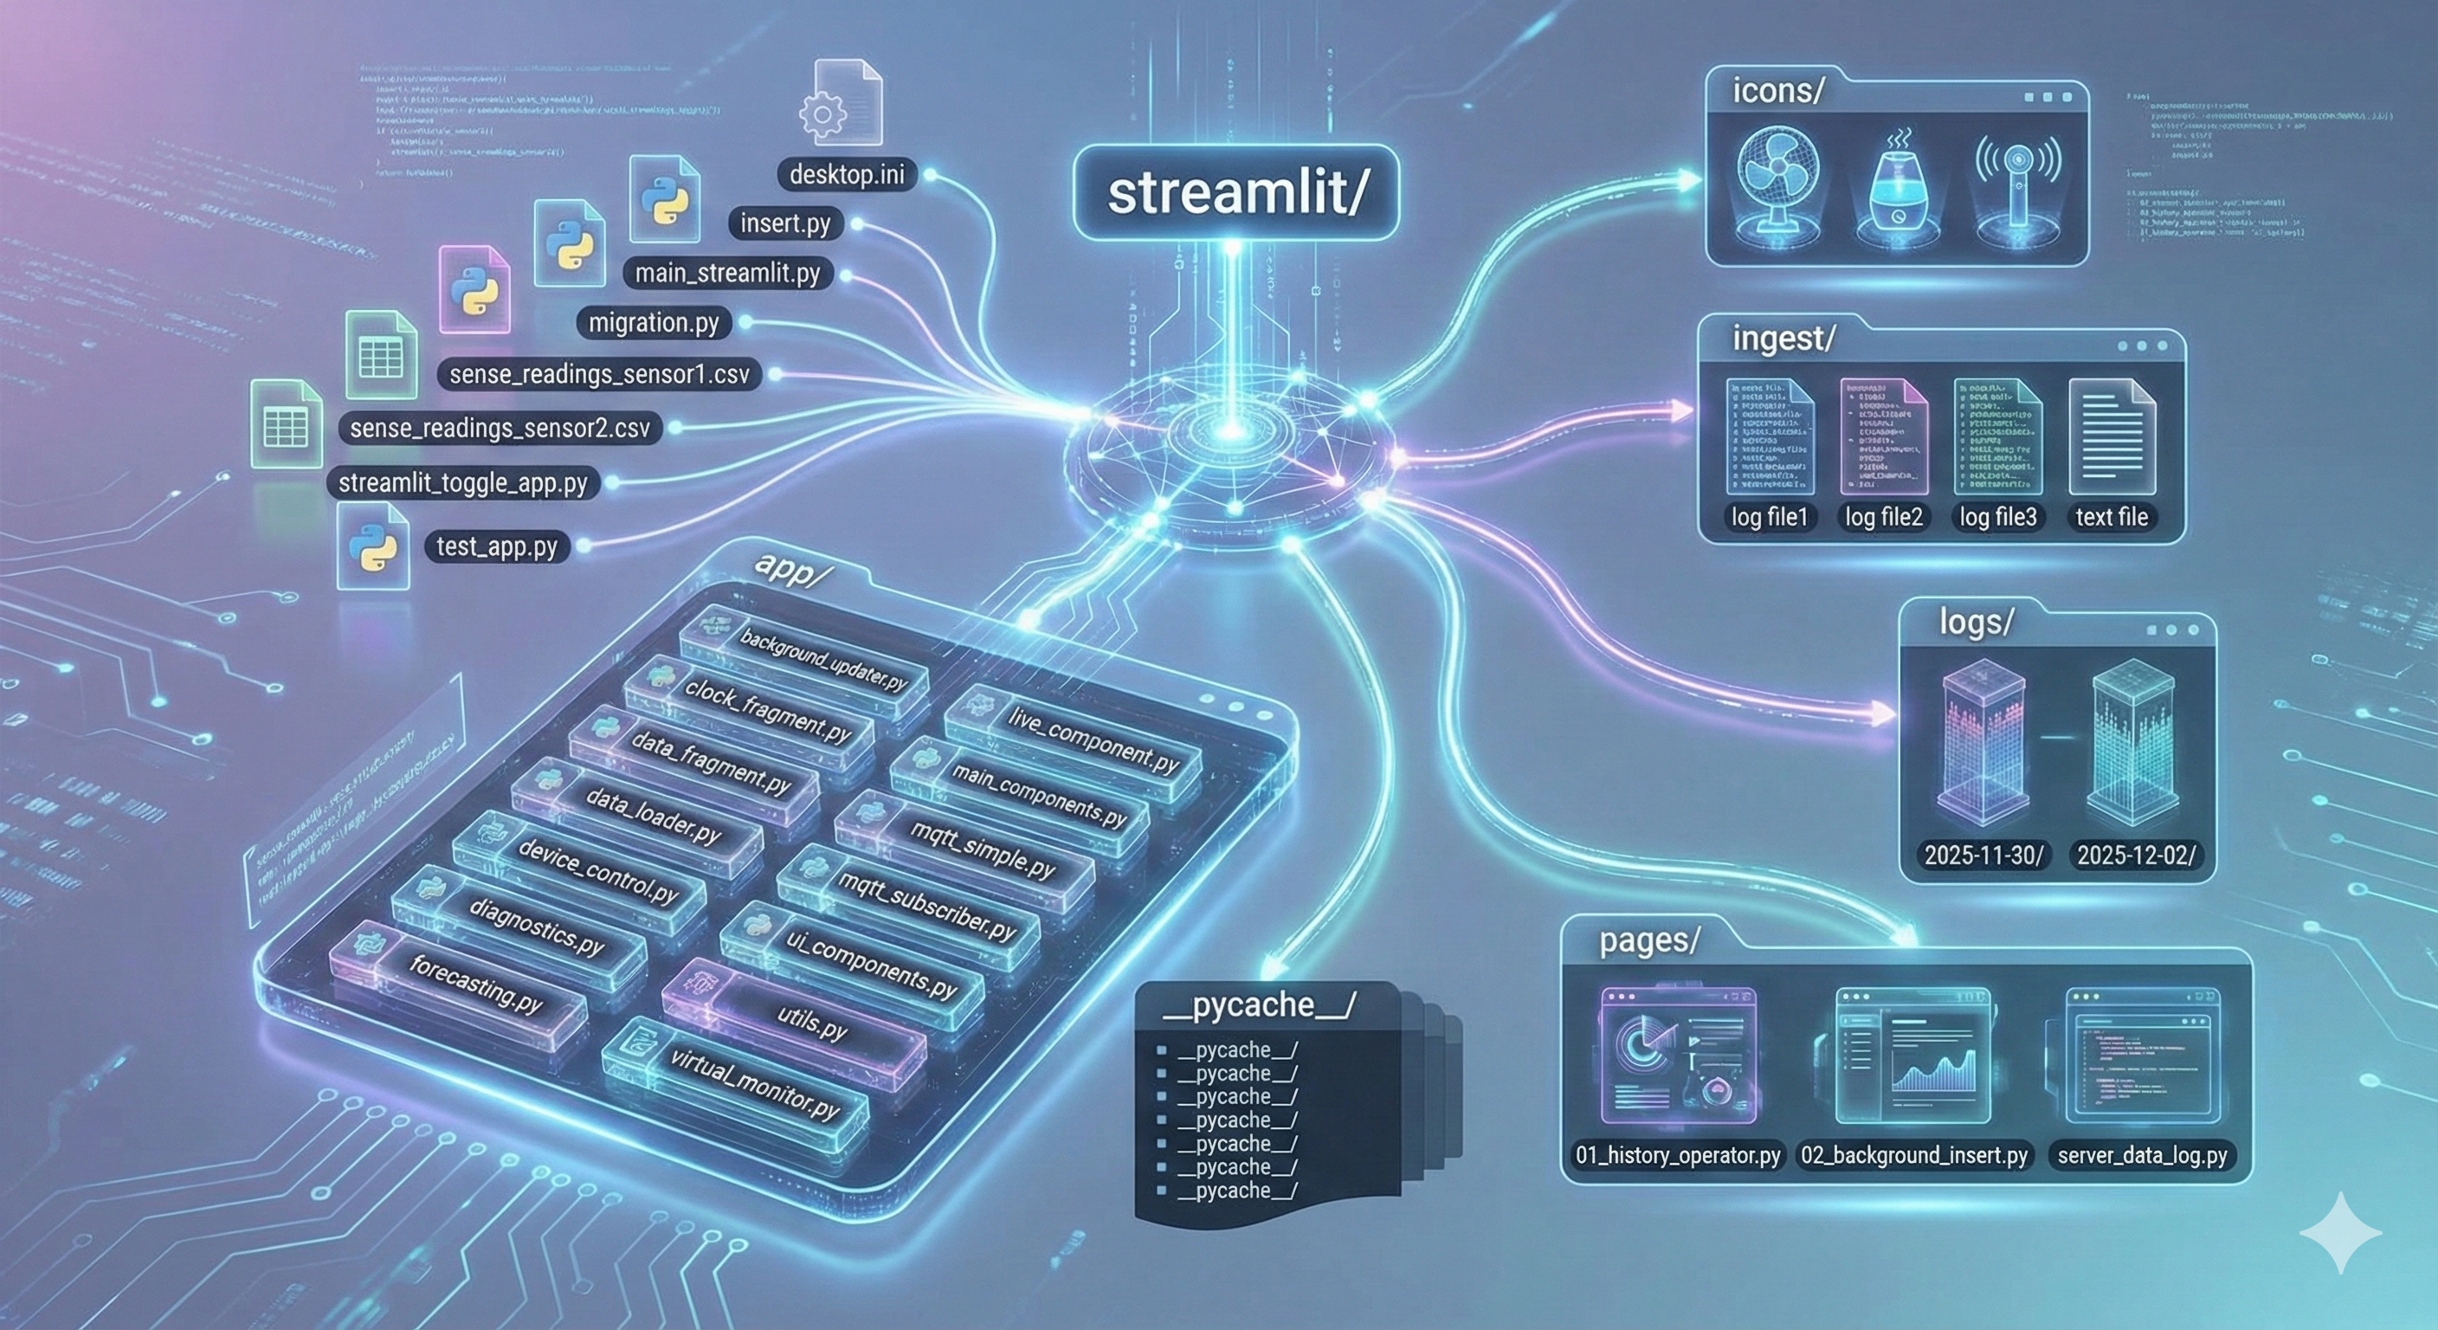
Contents
01 Problem Overview & Objectives
02 System Architecture Overview
03 Layer-by-Layer Design & Implementation
04 Demo
05 Results, Challenges & Lessons Learned
06 Conclusion & Future Extensions

Slide 3
Problem Statement
In many small environments that require stable humidity (e.g., labs or storage spaces), we want to automatically maintain constant (for eg. 40–60%) relative humidity using IIoT, with remote monitoring, historical data tracking, and predictive analytics that adjust the control thresholds to improve stability, reduce energy waste, and minimize manual checks.
This idea can be extended to any set of data control and how IIOT structure can aid the field.

Slide 4
Problem Overview & Objectives
Real-world problem / scenario
Electronics assembly rooms: need controlled humidity to reduce static damage and corrosion on PCBs.
Pharmaceutical or lab storage: materials and samples degrade if humidity is not tightly controlled.
Food processing / packaging areas: humidity affects clumping, mold risk, and shelf life.
What our prototype demonstrates
A Raspberry Pi + sensors + humidifier + fan
Automatic humidity control plus platform‑based monitoring
Why IIoT is needed
Centralized monitoring of multiple rooms in the future
Historical data for analysis and optimization
Easy integration with alarms, reports, or other systems

Slide 5
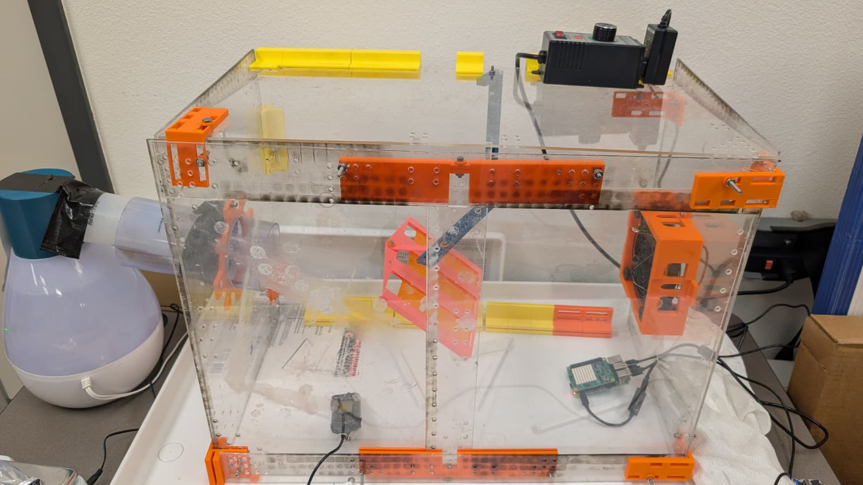
Our Humidity Control System
Humidifier
Fan
Sensor 1
Sensor 2
(sense hat mounted on RaspB. Pi 4)

Slide 6
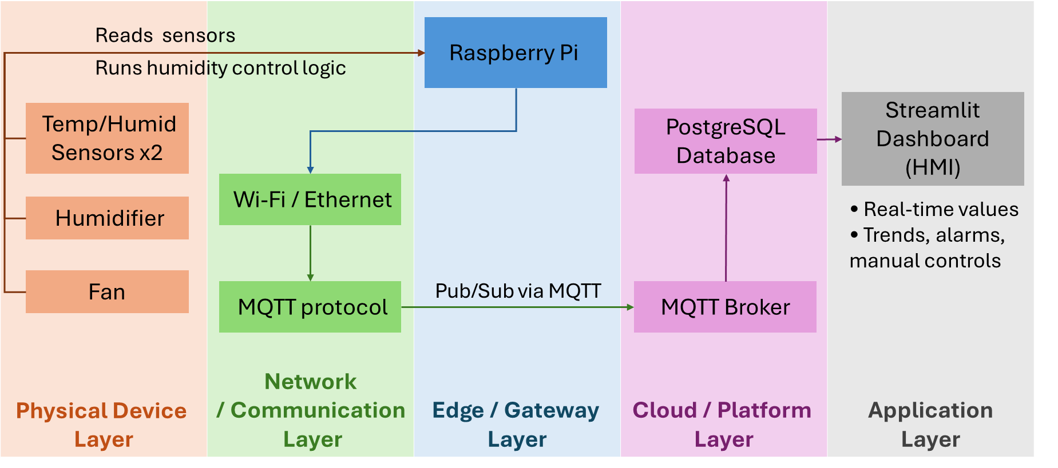
System Architecture Overview

Slide 7
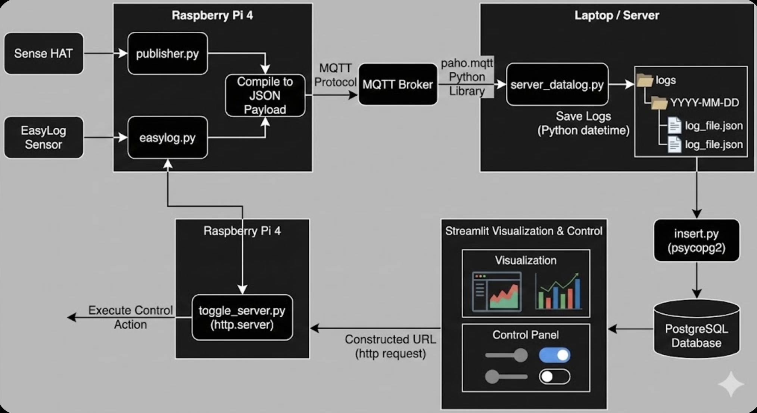
Data Flow Pipeline

Slide 8
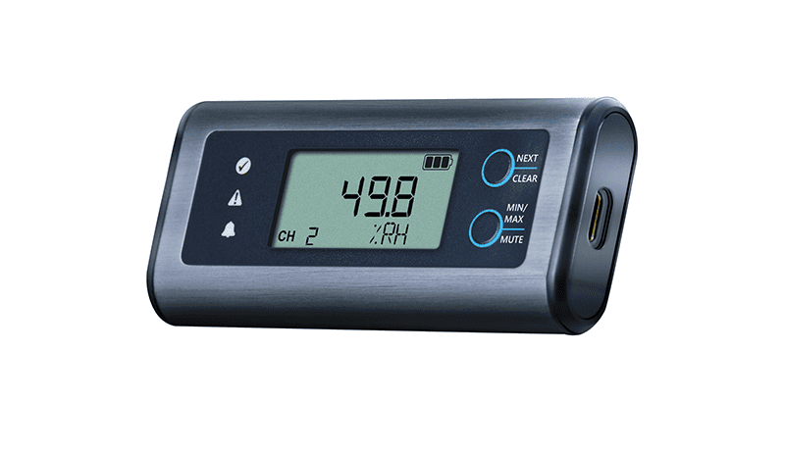
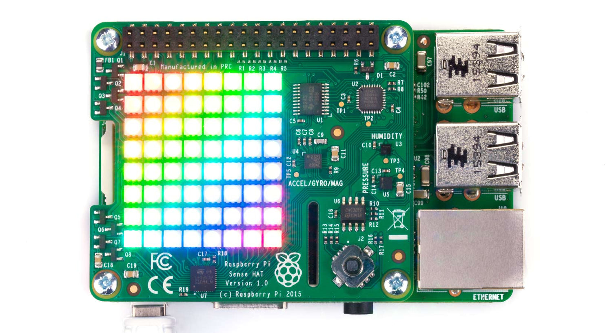
Physical Device Layer
Sensors
Two temperature & humidity sensorsat slightly different positions
Sampling interval: every 1 seconds
Actuators
One fan works with USB Power hubfrom RaspberyPi

Slide 9
Network / Communication Layer
Protocol: MQTT
Reasons:
Lightweight and efficient for small messages
Publish–subscribe pattern, easy to scale
Very Low Power Consumption
Works Over Unstable Networks
Simple and Human-Readable Message Format
http://192.168.137.22:8000

Slide 10
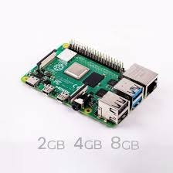
Edge / Gateway Layer
Edge device: Raspberry Pi (Raspberry Pi OS)
Functions (Python or Node‑RED):
Read the three sensors
Execute control logic (comparehumidity and switch devices)
Pack data into JSON and publish toMQTT
Subscribe to command topics forremote manual control
Local filtering example:
Only publish when the value changesby more than 1% to avoid spamming

Slide 11
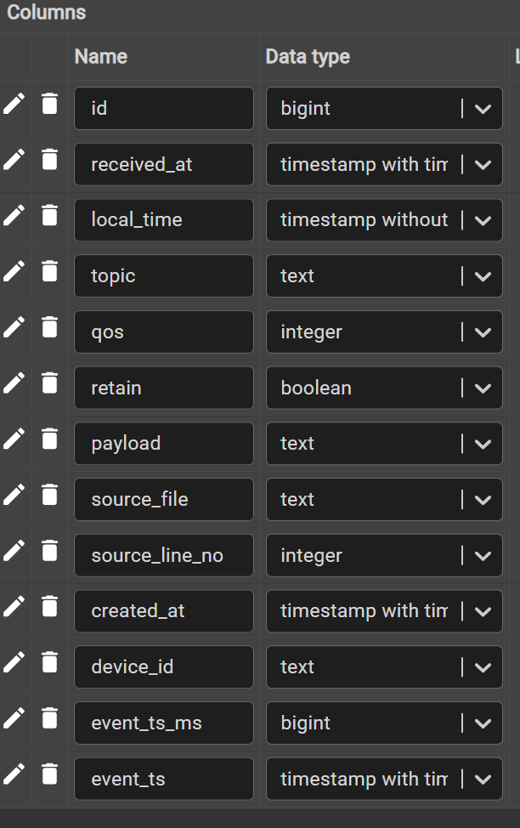
Cloud Platform Layer
Platform: Ignition Gateway running on an on‑premise server or laptop
Data pipeline:
MQTT Engine subscribes to topics and creates tags
Historian module writes tag history to a database (PostgreSQL)
Analytics (simple):
Weighted average humidity over most recent 60 readings.
Percentage of time outside the set range
Trend charts and simple reports inside streamlit.
Using Forecasting Strategies like (Triple Exponential Smoothing, Double Exponential Smoothing, & Single Exponential Smoothing).

Slide 12
Application Layer
HMI / Dashboard
Displays:
Real‑time temperature and humidity from the two sensors
ON/OFF status of fan and humidifier
Gauges or trend charts
Indicator (green/red) showing whether the area is within the target range
Interactions:
Manual control buttons to override automatic mode (great for the demo)
Simple alarm (indicator turns red when humidity goes outside 40–60%)

Slide 13
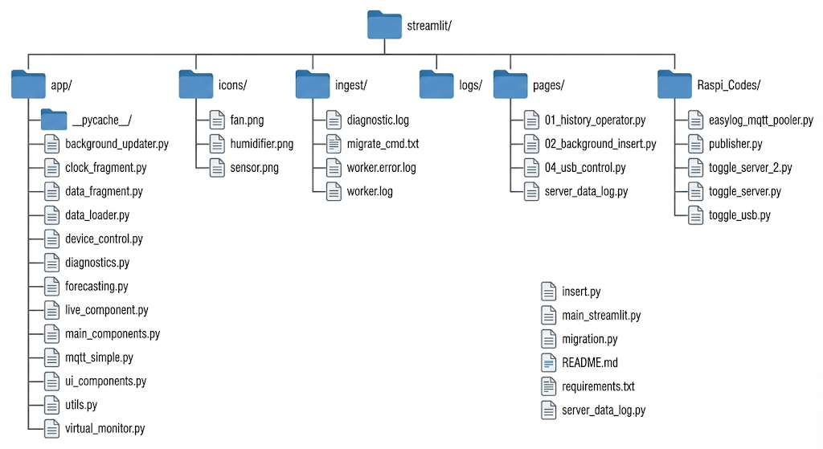
Project File & Module Structure

Slide 14
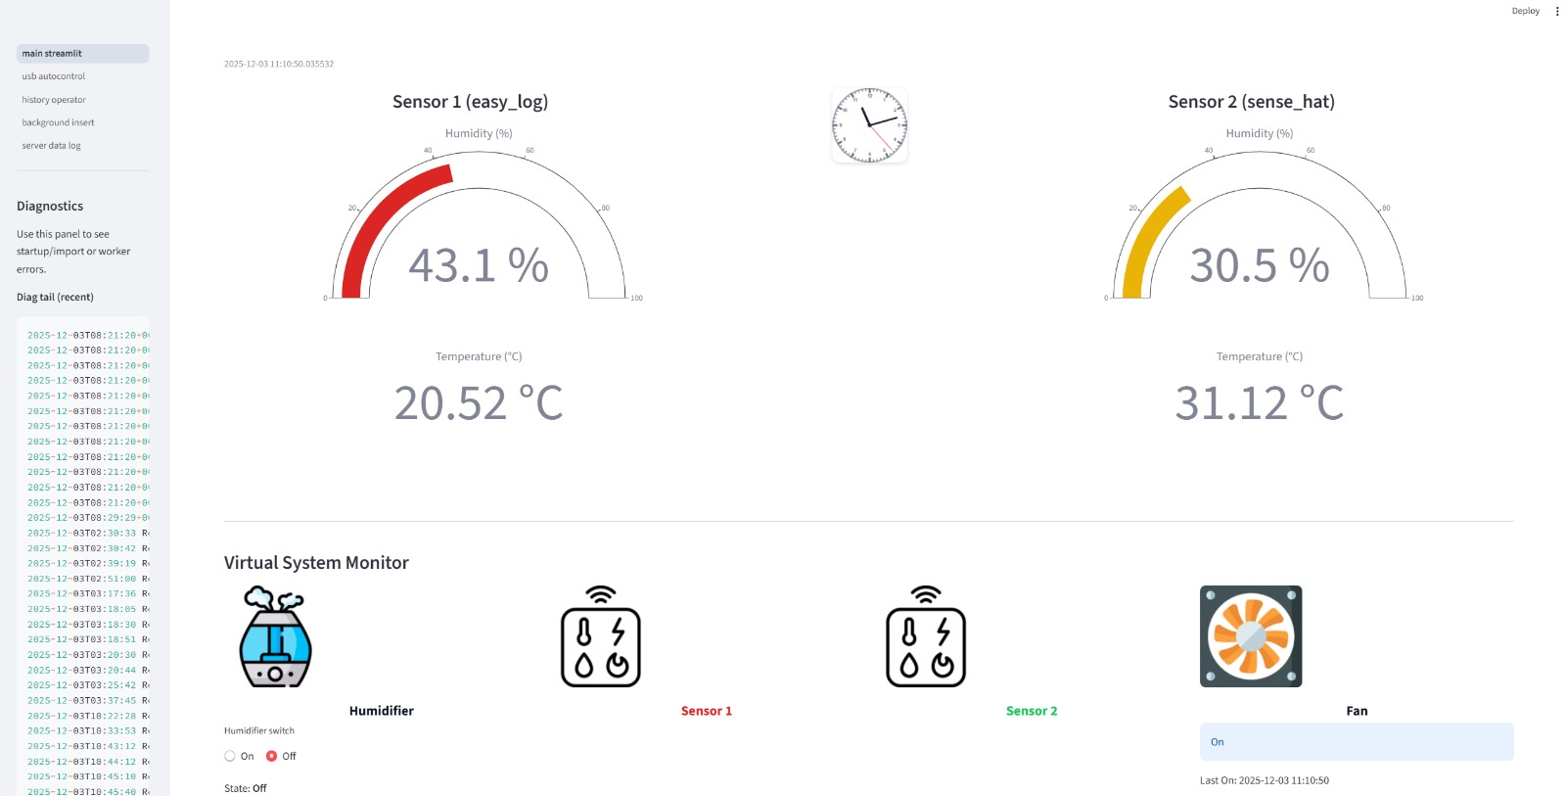
Main Dashboard

Slide 15
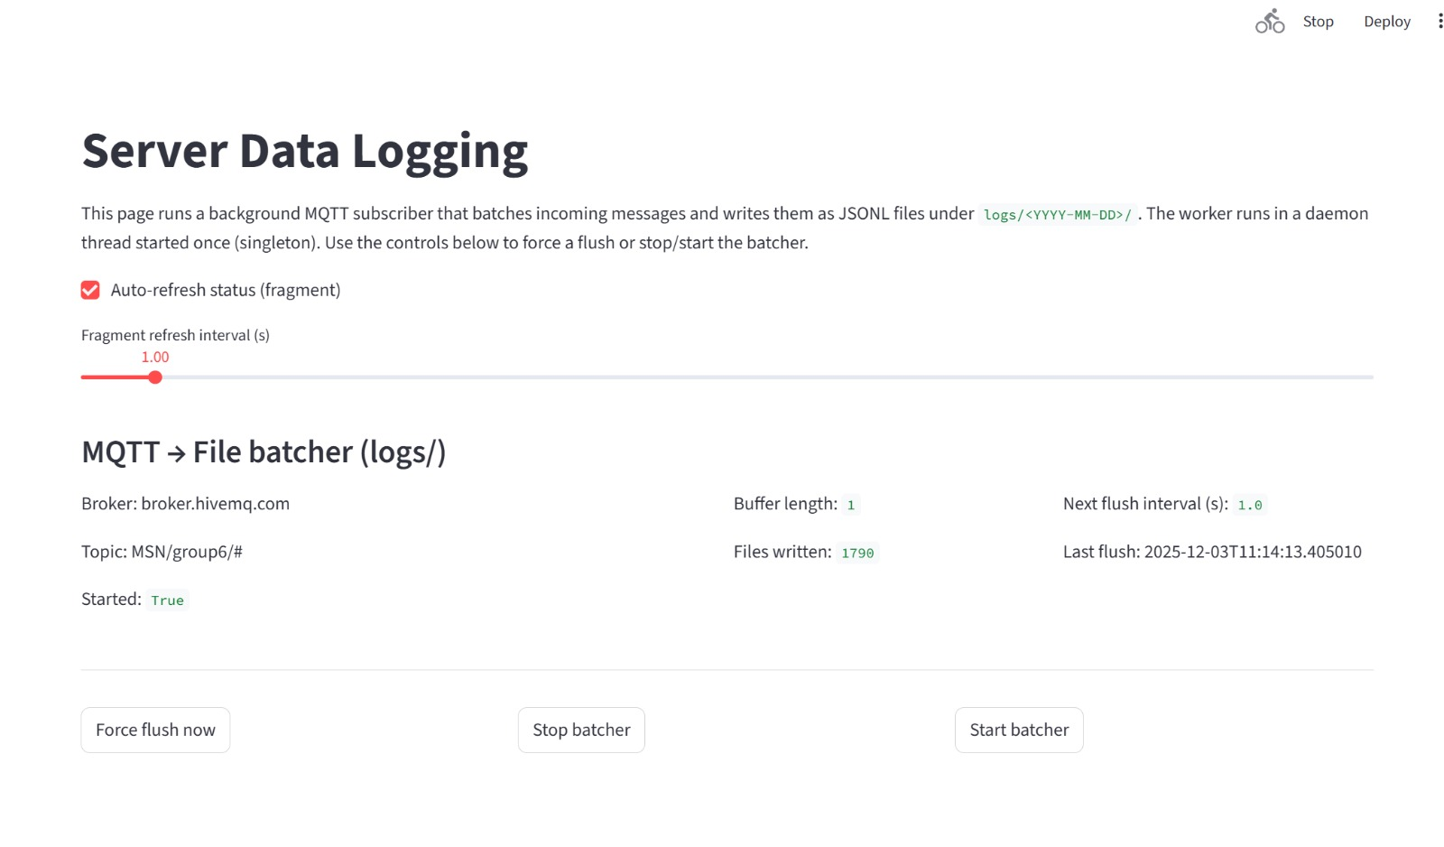
Data Logging

Slide 16
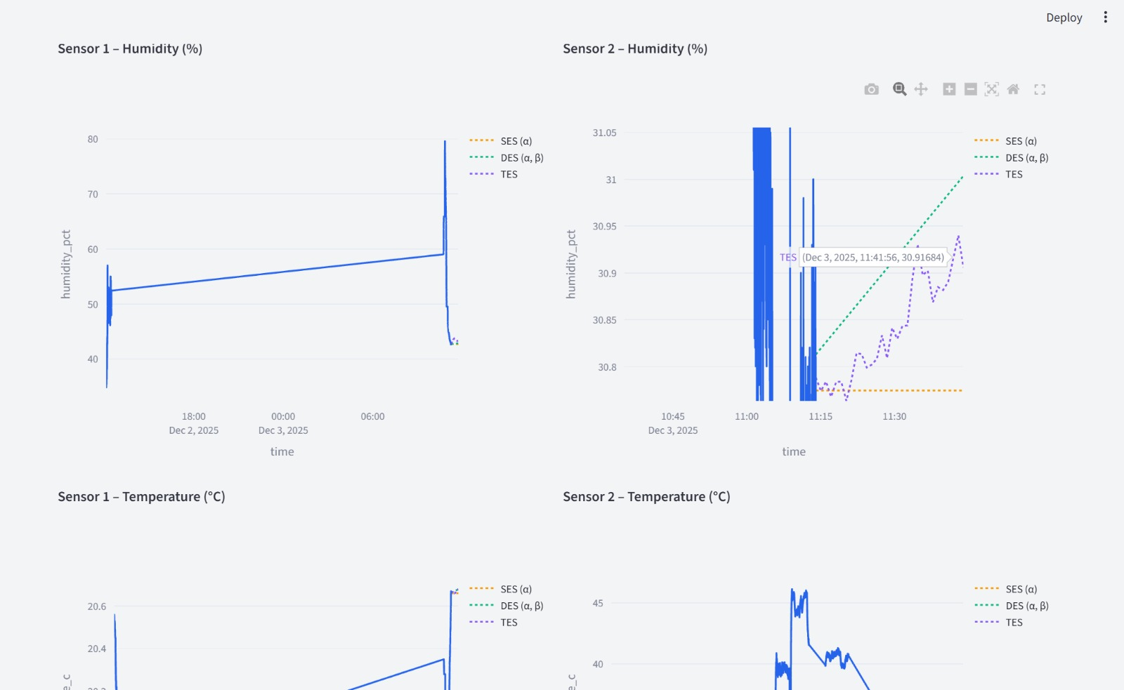
Sensor Data Analysis

Slide 17
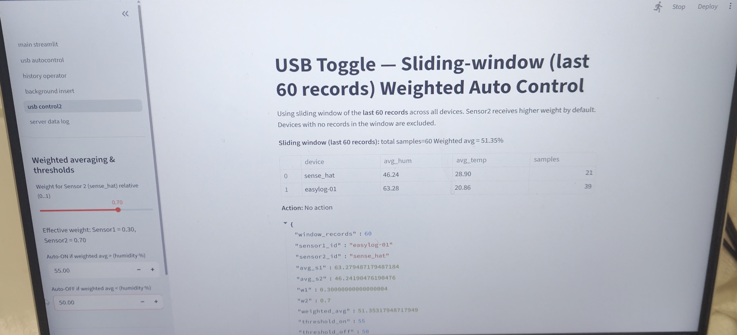
Fan Control

Slide 18
Demo
Data generation
Show the physical setup on camera.
Point out the current humidity values on the Ignition dashboard.
Use a spray bottle / turn the humidifier on or off to change humidity and watch the readings move.
Message transmission via MQTT
Open a simple MQTT client (e.g., MQTT Explorer or a Node‑RED debug node).
Show JSON messages being published in real time as the humidity changes.
Edge logic
Briefly show the Python code or Node‑RED flow on the Pi.
Point at the section that implements the dashboard controlled logic.
Cloud reception + database storage
In Ignition, open a trend chart.
Scroll back a few minutes to prove that historical data is being stored.

Slide 19
Conclusion
Successfully demonstrated a complete IIoT pipeline, from sensing to control to visualization.
Achieved reliable real-time humidity monitoring and automated actuation using Raspberry Pi and MQTT.
Implemented a robust data architecture with logging, database storage, and analytical capabilities.
Validated remote control functionality, proving that IIoT enables centralized and efficient management.
Showcased how IIoT improves stability, reduces manual intervention, and supports data-driven decision-making.

Slide 20
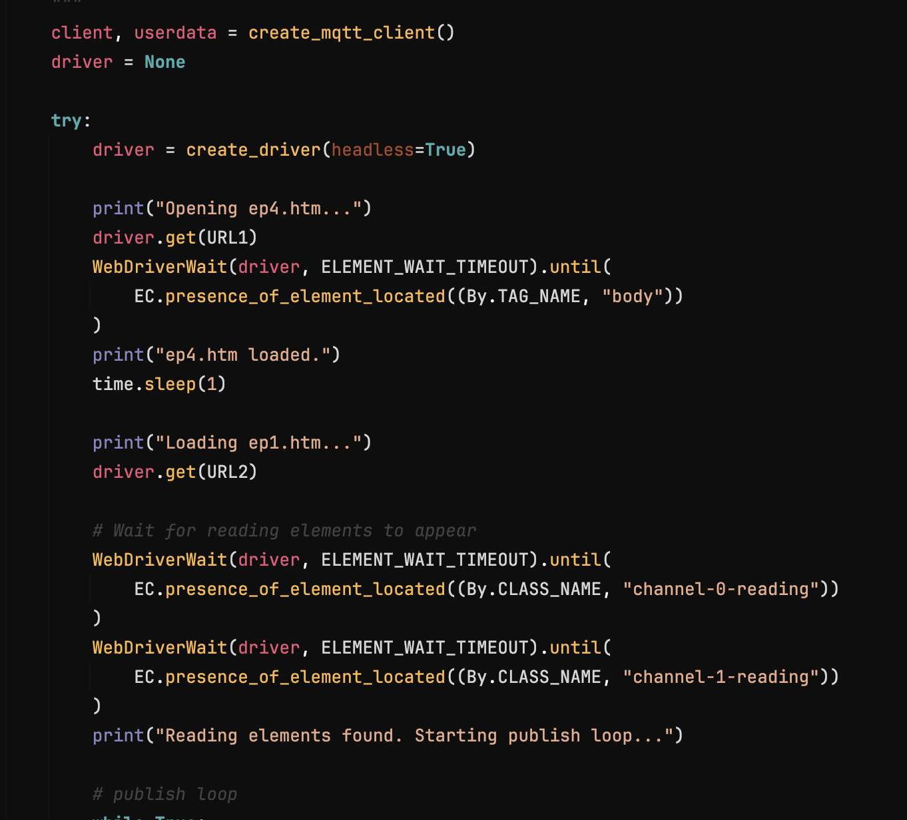
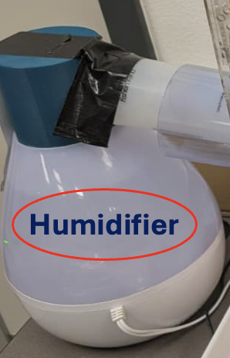
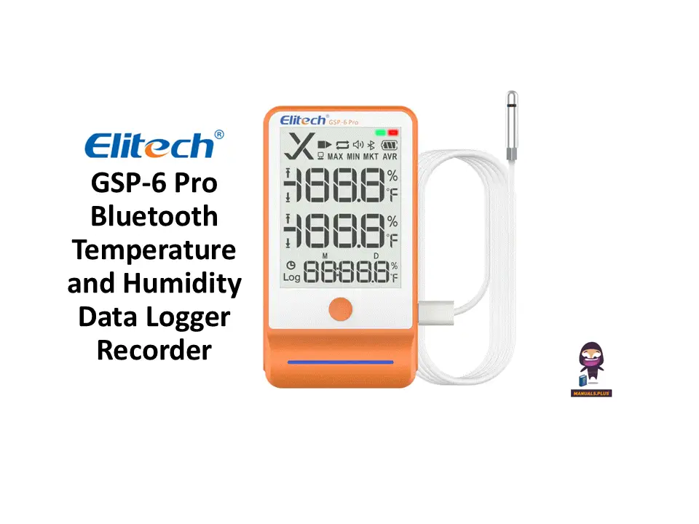
Challenges
Easylogger is not compatible for raspberry Pi, so we needed to run web scrapping and get data from the loggers default dashboard.
run(["sudo", "uhubctl", "-l", USB2_HUB, "-a", "off"])
Couldn’t Control and Decode

Slide 21
Future Extensions
Scale to multi-room, multi-sensor monitoring using the same MQTT + database architecture.
Add predictive/AI-based humidity control for smarter, energy-efficient operation.
Integrate industrial protocols like OPC UA for interoperability with real factory systems.
Enable automated alerts & reporting through email/SMS and compliance-ready logs.
Deploy cloud dashboards & remote control for monitoring and managing environments from anywhere.

Slide 22
Thank you! Q&A

